Slide 1
Information Visualization Project
S AJAY [RA1911003010102]
TARUUN P [RA1911003010103]
SAIPAVAN TIPPANU [RA1911003010121]
S KARTHIKEYAN [RA1911003010120]
Diabetes predictions and its contributors

Slide 2
The Visualizations used are:
Univariate Analysis
Bivariate analysis
Marginal Distribution
Kernel Density Estimation
Correlation Matrix
Confusion Matrix

Slide 3
Univariate Analysis
Univariate analysis explores each variable in a data set, separately. It looks at the range of values, as well as the central tendency of the values. It describes the pattern of response to the variable. It describes each variable on its own. Descriptive statistics describe and summarize data.
Observations-

Slide 4
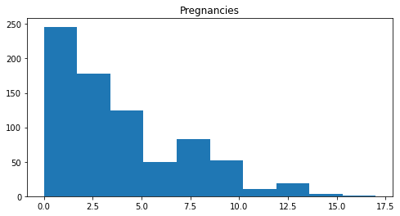
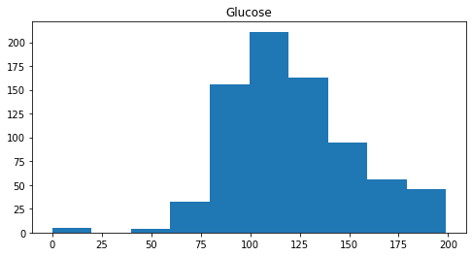
This depicts the number of pregnancies that are there amongst the dataset . Here, we can clearly see the number of pregnancies rates. i.e How many people have a certain number of pregnancy periods.
This graph depicts the glucose levels of the people pertaining to the dataset. There are many people with high glucose levels in the middle sector of the graph.

Slide 5
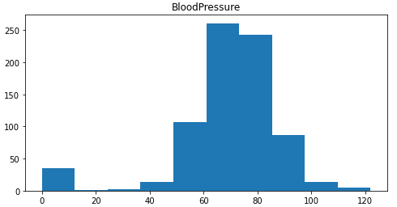
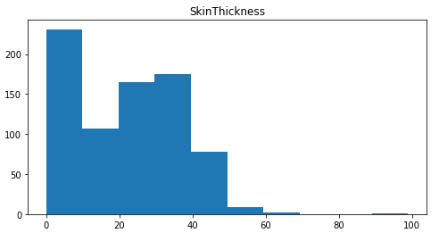
This graph depicts the blood pressure levels of the people pertaining to the dataset. Here, we can see that many people have BP within the range of 60-85 and a less number of people have less than 40.
This graph depicts the skin thickness of the people pertaining to the dataset.
Here we can see that many people have skin thickness ranging from 0-40 and very minimal people have it in the range of 50+.

Slide 6
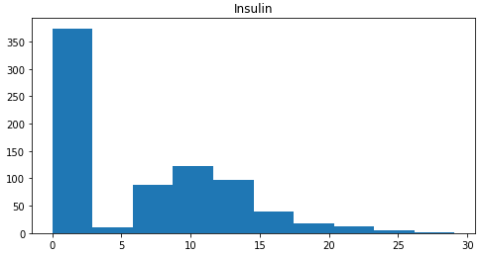
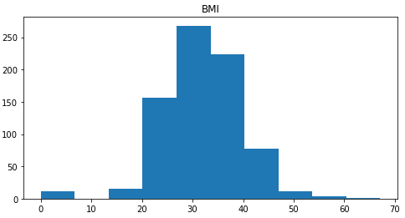
This graph depicts the insulin levels of the people pertaining to the dataset
Here we can see that people have high insulin ranging from 0-3 and starts to gradually decrease from its second peak at 10.
This graph depicts the BMI of the people pertaining to the dataset.
Here we can see that BMI peaks out at 30 and is high in the range of 20-45 .

Slide 7
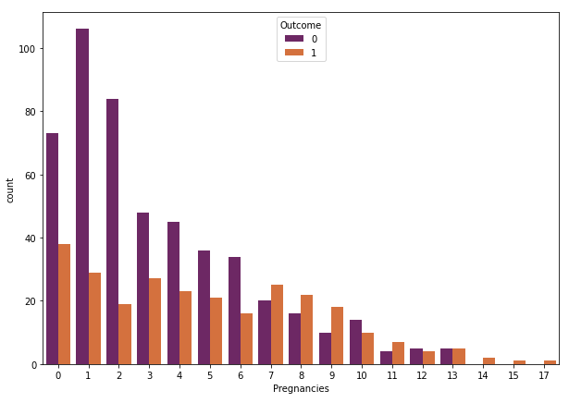
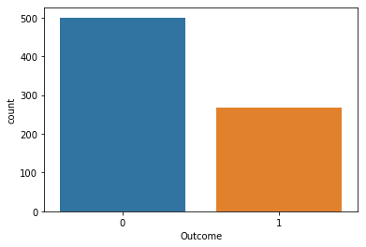
On applying this we can visualize
In this graph we can observe the outcome of the univariate analysis based on the previous graph's data as input. This graph can be deciphered by taking the orange as has diabetes and blue as does not have diabetes.
Via this visualization, we can see that pregnancies might not always contribute to diabetes as the outcome of most of the pregnant women are not diabetic. This shows us that this might not only be the main contributing factor if the patient is diabetic.

Slide 8
Bivariate analysis
Bivariate analysis is not the same as two sample data analysis. With two sample data analysis (like a two sample z test in Excel), the X and Y are not directly related. You can also have a different number of data values in each sample; with bivariate analysis, there is a Y value for each X

Slide 9
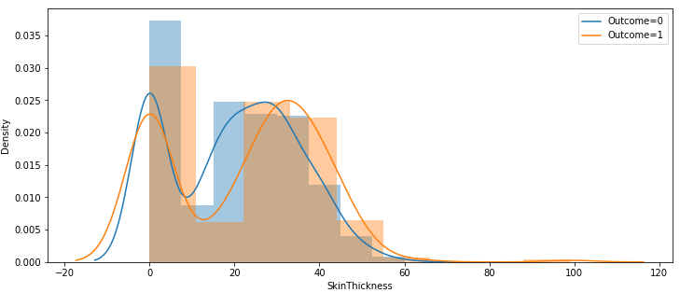
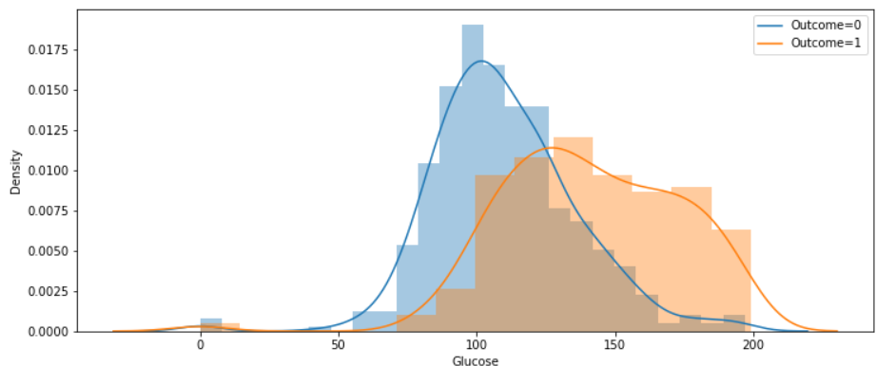
In this Graph we are able to grasp the correlation between thickness of skin and having diabetes . The graph also shows that, the outcome of diabetes is nearly the same for all the people of different skin thickness. Only in the vicinity of 0.025 density of 0 skin thickness and around 10-20, there is a clear correlation where we can see that the outcome is 0. And from around 30-60, the outcome is 1 where, we can conclude that this might be a contributing factor for diabetes.
In this Graph we are able to grasp the correlation between Glucose and having Diabetes . The graph depicts the glucose level is directly proportional to the chances of diabetes. We can clearly see the graphs outcome around 100-250, the outcome 1.where, we can conclude that this might be a contributing factor for diabetes.

Slide 10
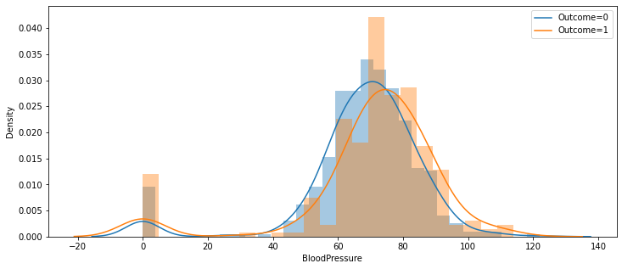
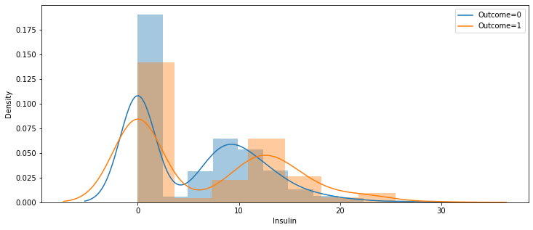
In this Graph we are able to grasp the correlation between Insulin and having Diabetes. The variance in insulin levels play a crucial role in telling a person if he has diabetes or not. As we can see from the graph the region around 5-12 has the outcome of 0 but from 15 and higher the outcome is 1. So higher or lower the insulin level, the more likely a person has diabetes. Ie. having less or excess amount of insulin might lead to diabetes.
In this Graph we are able to grasp the correlation between blood pressure and having diabetes. The graph hasn't shown much
variance till 40 but from 40-120 there is a slight variance.
The dataset shows that people who have a bp higher than
80 has a higher chance of diabetes.

Slide 11
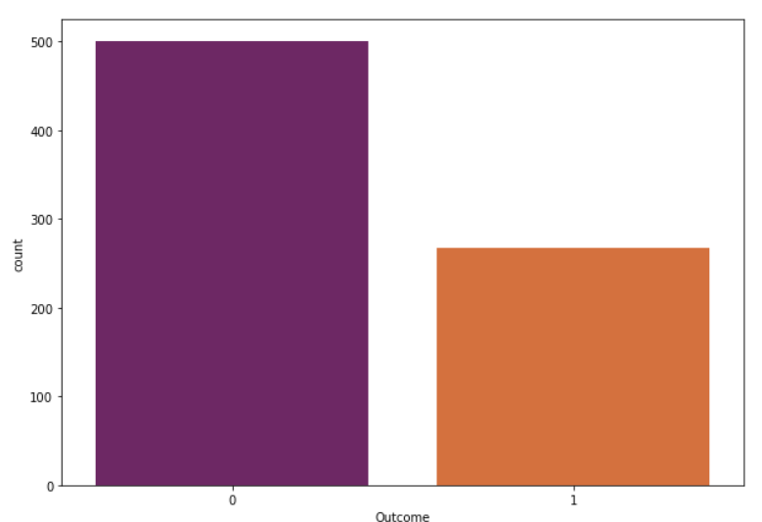
In this graph we can observe the
outcome of the Bivariate analysis
based on the previous graph's data
as input. This graph can be
deciphered by taking the orange
as has diabetes and purple as
does not have diabetes.

Slide 12
Marginal Distribution
The marginal distribution of a subset of a collection of random variables is the probability distribution of the variables contained in the subset. It gives the probabilities of various values of the variables in the subset without reference to the values of the other variables. This contrasts with a conditional distribution, which gives the probabilities contingent upon the values of the other variables.
Marginal variables are those variables in the subset of variables being retained. These concepts are "marginal" because they can be found by summing values in a table along rows or columns, and writing the sum in the margins of the table.^{[1]} The distribution of the marginal variables (the marginal distribution) is obtained by marginalizing – that is, focusing on the sums in the margin – over the distribution of the variables being discarded, and the discarded variables are said to have been marginalized out.
The context here is that the theoretical studies being undertaken, or the data analysis being done, involves a wider set of random variables but that attention is being limited to a reduced number of those variables. In many applications, an analysis may start with a given collection of random variables, then first extend the set by defining new ones (such as the sum of the original random variables) and finally reduce the number by placing interest in the marginal distribution of a subset (such as the sum). Several different analyses may be done, each treating a different subset of variables as the marginal variables.

Slide 13
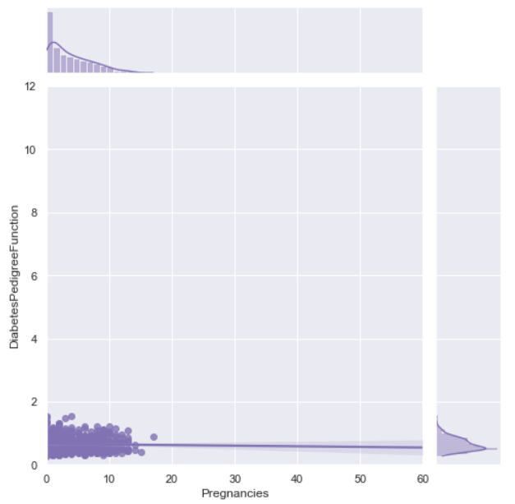
In this graph we are able to perceive the correlation between Diabetes Pedigree Function and Pregnancies. The number of pregnancies doesn't matter in this case as the diabetes pedigree function stays constant throughout. On the side we have the marginal side plots, wherein we can see the marginal distribution pertaining to diabetes pedigree function and pregnancies. It increases at the start and slopes down as the density decreases.

Slide 14
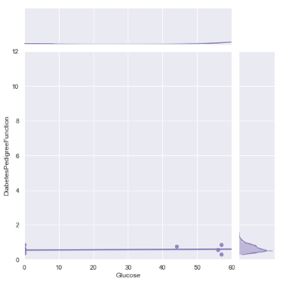
In this graph we are able to perceive the correlation between Diabetes Pedigree Function and Glucose . The factor of glucose doesn't contribute much in this case as the diabetes pedigree function stays constant throughout. On the side we have the marginal side plots, wherein we can see the marginal distribution pertaining to diabetes pedigree function and glucose. In this only at the end of the graph does the density and the graph have some minimal density and value because of which we can say that this is not that big of a factor of diabetes.

Slide 15
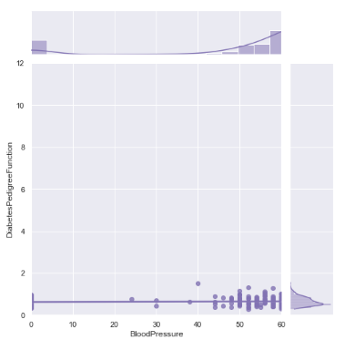
In this graph we are able to perceive the correlation between Diabetes Pedigree Function and Blood Pressure.The factor of Blood pressure doesn't contribute much as in this case as the diabetes pedigree function stays constant throughout at the beginning. On the side we have the marginal side plots, wherein we can see the marginal distribution pertaining to diabetes pedigree function and Blood Pressure. It starts to increase in the middle and spike up as the density increases. So, we can conclude that only above a certain margin, diabetes pedigree function might matter.

Slide 16
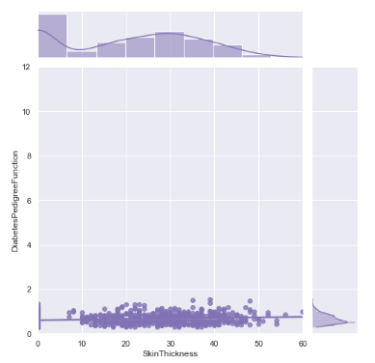
In this graph we are able to perceive the correlation between Diabetes Pedigree Function and Skin Thickness. The factor of Skin thickness contributes a lot as in this case as the diabetes pedigree function stays in the middle throughout and has a lot of density. On the side we have the marginal side plots, wherein we can see the marginal distribution pertaining to diabetes pedigree function and Skin Thickness. It increases at the start and slopes down a little then shoots up again as the density increases and gradually slopes down as the density decreases.

Slide 17
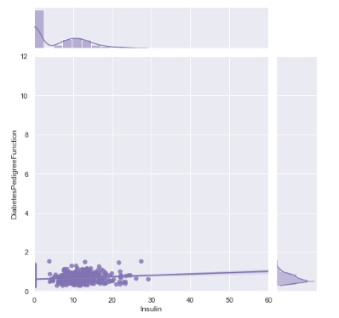
In this graph we are able to perceive the correlation between Diabetes Pedigree Function and Insulin. The factor of Insulin contributes initially as in this case as the diabetes pedigree function varies throughout at start. On the side we have the marginal side plots, wherein we can see the marginal distribution pertaining to diabetes pedigree function and Insulin.It increases at the start and slopes down a little then shoots up again as the density increases and gradually slopes down as the density decreases and flatlines. We can conclude this by saying that, a lot of people take in insulin when they have diabetes, wherein Diabetes pedigree function might be a factor.

Slide 18
Kernel Density Estimation
Kernel density estimation (KDE) is a non-parametric way to estimate the probability density function of a random variable. Kernel density estimation is a fundamental data smoothing problem where inferences about the population are made, based on a finite data sample. In some fields such as signal processing and econometrics it is also termed the Parzen–Rosenblatt window method, after Emanuel Parzen and Murray Rosenblatt, who are usually credited with independently creating it in its current form. One of the famous applications of kernel density estimation is in estimating the class-conditional marginal densities of data when using a naive Bayes classifier,which can improve its prediction accuracy.

Slide 19
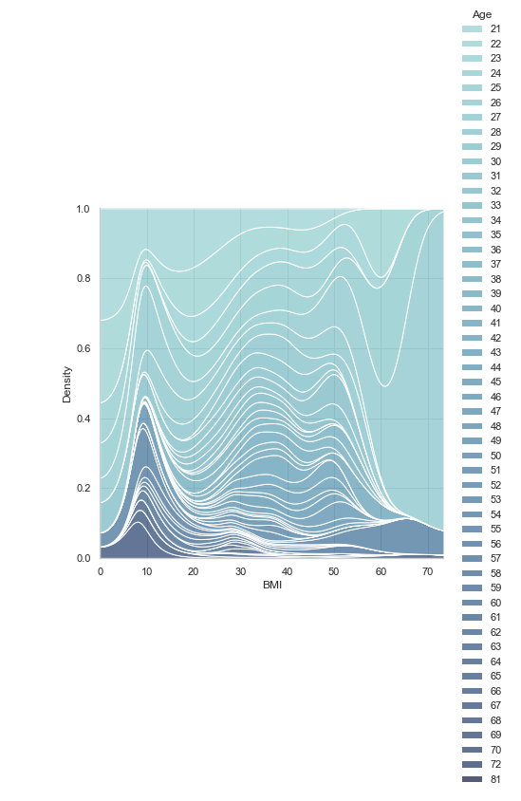
In this graph we are able to visualize the correlation between age and bmi as a factor of having diabetes. The bottom quarter of the relation is dominated by the old people, since their BMI is usually quite low as they tend to lose weight.ie. in the area around 10 BMI. The middle part consists of the age group of around 40- 55. The upper portion of the viz. Consists of lower aged people since they tend to be of different weight and height proportions.

Slide 20
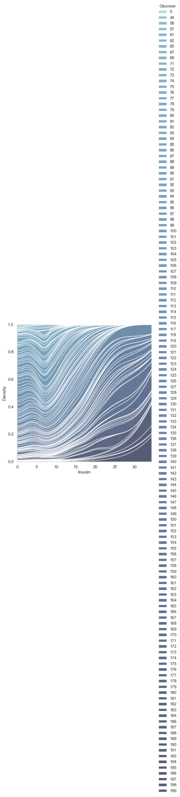
In this graph we are able to visualize the correlation between the insulin level and glucose as a factor of having diabetes. Consider the levels from 5-15 the glucose levels are in the middle level but as the number goes up around 20 to 30 the graph gets darker. We can conclude from the graph that with the increasing levels of insulin, the glucose also goes higher.

Slide 21
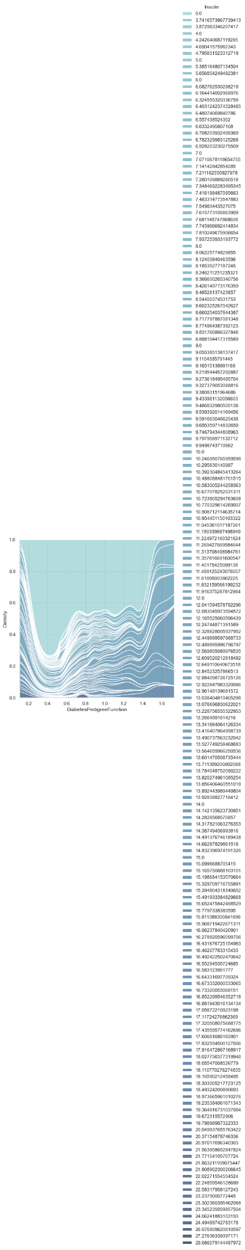
In this graph we can visualize the correlation between the insulin level and diabetes pedigree function as a factor of having diabetes. Diabetes pedigree function (a function which scores likelihood of diabetes based on family history).
We can see from the graph that the low levels around 0 - 0.4 and 0.5 to higher levels it can be found easily. All the other middle area looks normal.

Slide 22
Correlation Matrix
A correlation matrix is simply a table which displays the correlation coefficients for different variables. The matrix depicts the correlation between all the possible pairs of values in a table. It is a powerful tool to summarize a large dataset and to identify and visualize patterns in the given data.
A correlation matrix consists of rows and columns that show the variables. Each cell in a table contains the correlation coefficient.
In addition, the correlation matrix is frequently utilized in conjunction with other types of statistical analysis. For instance, it may be helpful in the analysis of multiple linear regression models. Remember that the models contain several independent variables. In multiple linear regression, the correlation matrix determines the correlation coefficients between the independent variables in a model.

Slide 23
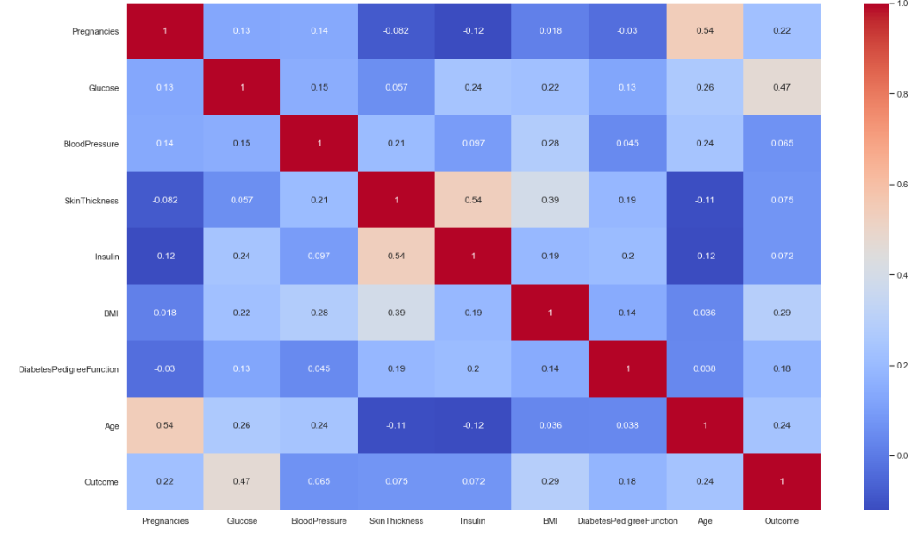
This matrix gives us a clear picture
of how each and every feature is
correlated to the other. The
warmer the label is, the more the
contributing factor it is in that
feature. This is also a diagonal matrix with value 1 where it has
its own feature repeated. The
other values correspond to the
relationship between the feature
and the other feature it is
contributing to.

Slide 24
Confusion Matrix
A confusion matrix is a table that is often used to describe the performance of a classification model (or "classifier") on a set of test data for which the true values are known. The confusion matrix itself is relatively simple to understand, but the related terminology can be confusing.
In the field of machine learning and specifically the problem of statistical classification, a confusion matrix, also known as an error matrix, is a specific table layout that allows visualization of the performance of an algorithm, typically a supervised learning one (in unsupervised learning it is usually called a matching matrix). Each row of the matrix represents the instances in an actual class while each column represents the instances in a predicted class, or vice versa – both variants are found in the literature.The name stems from the fact that it makes it easy to see whether the system is confusing two classes (i.e. commonly mislabeling one as another).

Slide 25
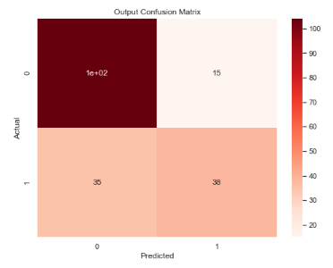
This matrix is derived after producing the
supervised training methods.
This confusion matrix gives a clear picture
of how each and every factor has contributed.
Eg. Accuracy,F1 score.

Slide 26
Conclusion
With the help of algorithms like Univariate, Bivariate, Scatterplot Matrix,
Linear Regression, Conditional Kernel density estimation , correlation matrix and confusion matrix we were able to visualize the relationship between the people can posses that could be a trait of having and possibly predicting a person having or getting Diabetes.
For reference, visit the link provided below:
Github Link:https://github.com/legendslayer01/Diabetes-IV-viz

Slide 27
Thank You

